Slide 1

Instructor: NGUYEN ANH MINH, MSc, PMP

Slide 2
Project Cost Management

Slide 3

Agenda
Definitions
Payback Period / Time Value of Money / PV
7.1 Plan Cost Management
7.2 Estimate Costs
7.3 Determine Budget
7.4 Control Costs
Earned Value Management
2

Slide 4
Project Cost Management
Cost Management includes the processes
involved in estimating, budgeting, and controlling costs so that the project can be completed within the approved budget.
Project managers must make sure their projects
are well defined, have accurate time and cost estimates and have a realistic budget that they were involved in approving
Costs are usually measured in monetary units
like dollars
3

Slide 5
Definitions (1)
Profit = Revenue – Costs
Profit Margin = Profit / Revenue
Cash flow refers to the movement of cash into or out of the project.
Direct costs are costs that can be directly related to producing the deliverable of the project: Salaries, cost of hardware & software purchased specifically for the project

Slide 6
Definitions (2)
Indirect costs are costs that are not directly related
to the deliverable of the project, but are indirectly related to performing the project, e.g. cost of electricity, Internet, rent and office supplies.
Reserves are dollars included in a cost estimate to mitigate cost risk by allowing for future situations that are difficult to predict

Slide 7
Definitions (3)
Sunk cost is money that has been spent in the past; when deciding what projects to invest in or continue, you should not include sunk costs
To continue funding a failed project because a
great deal of money has already been spent on it is not a valid way to decide on which projects to fund
Sunk costs should be forgotten

Slide 8
Definitions (4)
Variable Costs: change with the amount of production (cost of material).
Fixed Costs: do not change with production (rent, setup costs, … etc.)
Net present value: the total present value (PV) of
a time series of cash flows. It is a standard method for using the time value of money to appraise long-term projects

Slide 9
Definitions (5)
Internal Rate of Return: interest rate received for an investment consisting of payments and income that occur at regular periods
Opportunity Cost: The cost given up by selecting
one project over another.
Payback Period: The time it takes to recover
your investment in the project before you start accumulating profit.

Slide 10

Payback Period
Year | Project A | Project B
0 | -1,000 | -1,000
1 | 500 | 100
2 | 400 | 300
3 | 300 | 400
4 | 100 | 600

Slide 11
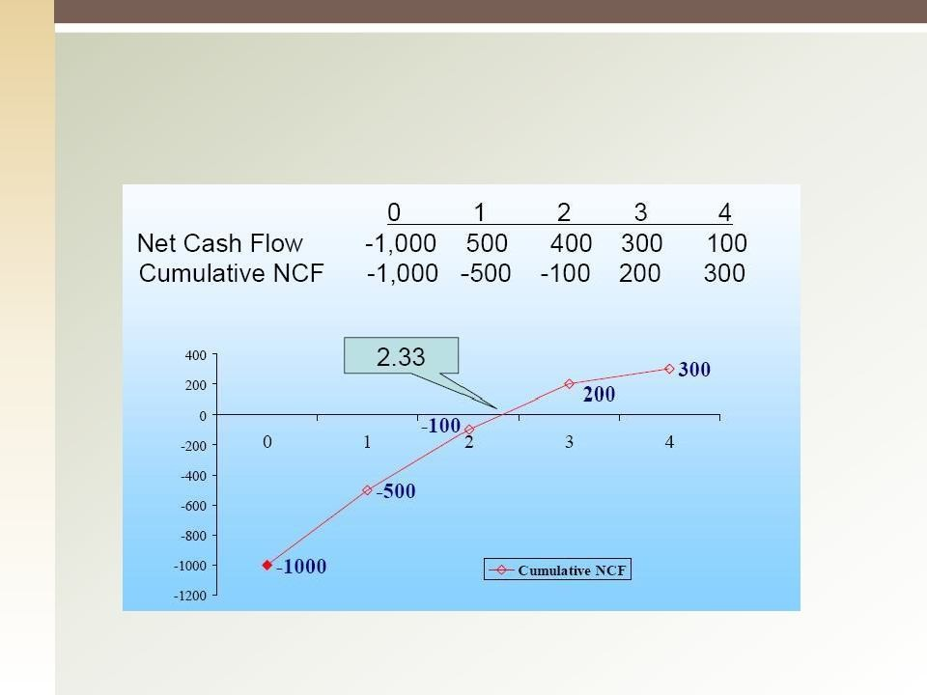
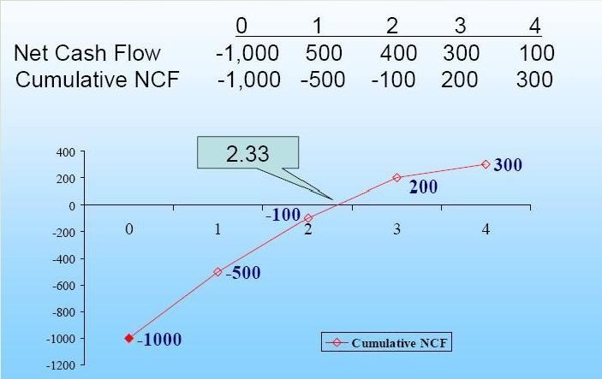
Project A
10

Slide 12
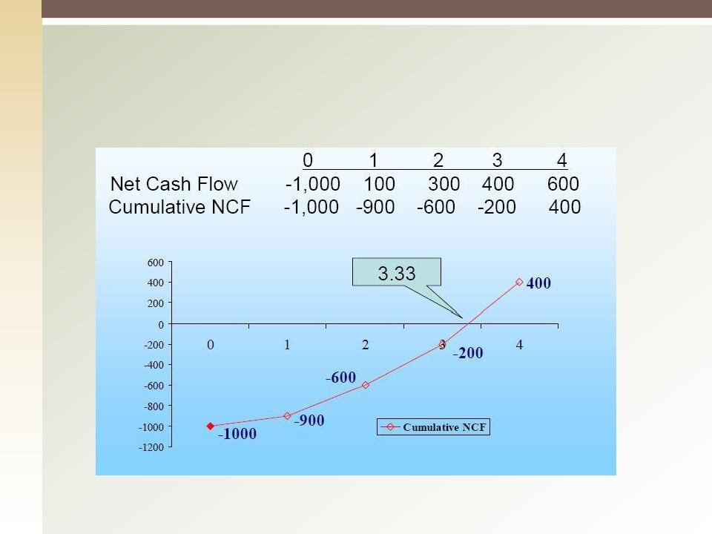
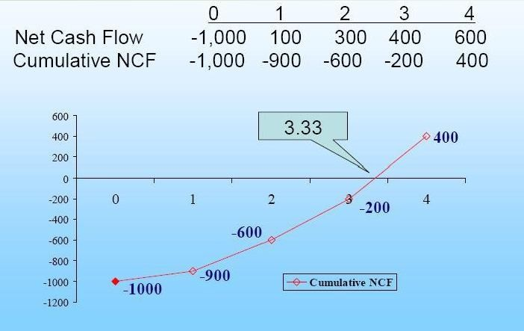
Project B

Slide 13
The Time Value of Money
A dollar received today is worth more than a dollar received tomorrow
This is because a dollar received today can be invested to earn interest
The amount of interest earned depends on the rate of return that can be earned on the investment


Time value of money quantifies the value of a dollar through time
▪ FV = PV * (1 + i)

Slide 14

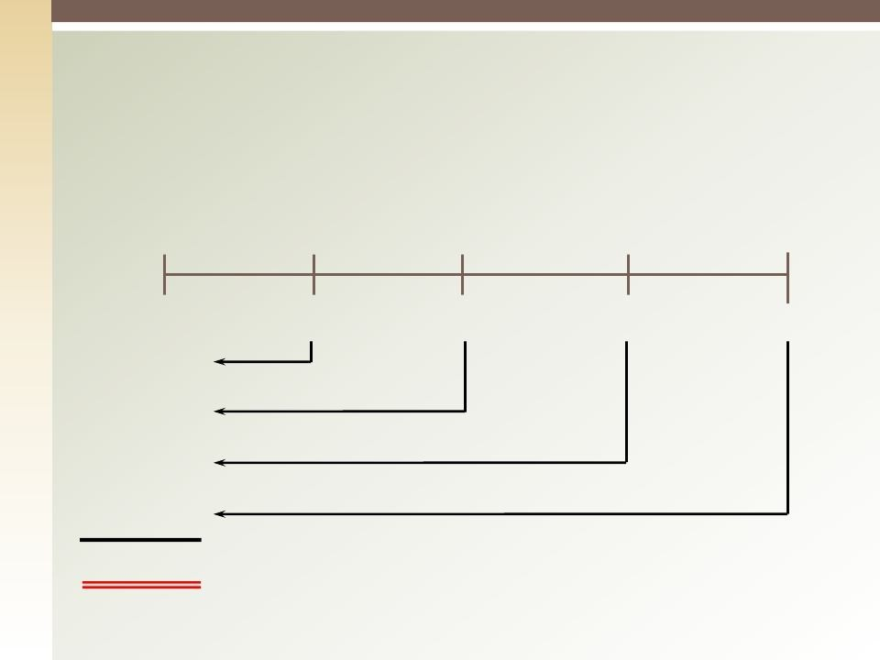
Example of PV Calculation
0
1
2
3
4
10%
100
300
300
-50
90.91
247.93
225.39
-34.15
530.08 = PV

Slide 15


7.1 Plan Cost Management
Establish the policies, procedures, & documentation for planning, managing, expending, and controlling project costs.
How the project costs will be managed.
14

Slide 16
Plan Cost Management: Inputs
Project Management Plan, contains but not limited to:
Scope Baseline
Schedule Baseline
Other Information (risks, communication, etc.) 2.Project Charter
3.Enterprise Environmental Factors 4.Organizational Process Assets

Slide 17
Plan Cost Management : T & T
Expert Judgment
Analytical Techniques
Meetings

Slide 18
Plan Cost Management : Output
Cost Management Plan, can include but not limited to
Units of Measure
Level of Precision
Level of Accuracy
Control Accounts
Control Thresholds
Rules for Performance Measurement
Reporting Formats
Process Description
Additional Details
17

Slide 19
7.2 Estimate Costs
The Process of developing an approximation (estimate) for the cost of the resources
necessary to complete the project activities
It is also important to develop a cost management plan that describes how cost variances will be managed on the project
Pricing: Assessing how much the organization will charge for the product or service

Slide 20
Estimate Costs: Inputs (1)
Cost Management Plan
Human Resource Management Plan
Scope Baselines
Scope Statement
WBS
WBS Dictionary
Project Schedule

Slide 21
Estimate Costs: Inputs (2)
Risk Register (Risk mitigation costs)
Enterprise Environmental Factors
Market Conditions
Published Commercial Data
Organizational Process Assets
Cost Estimating Policies
Cost Estimating Templates
Historical Information
Lessons Learned

Slide 22
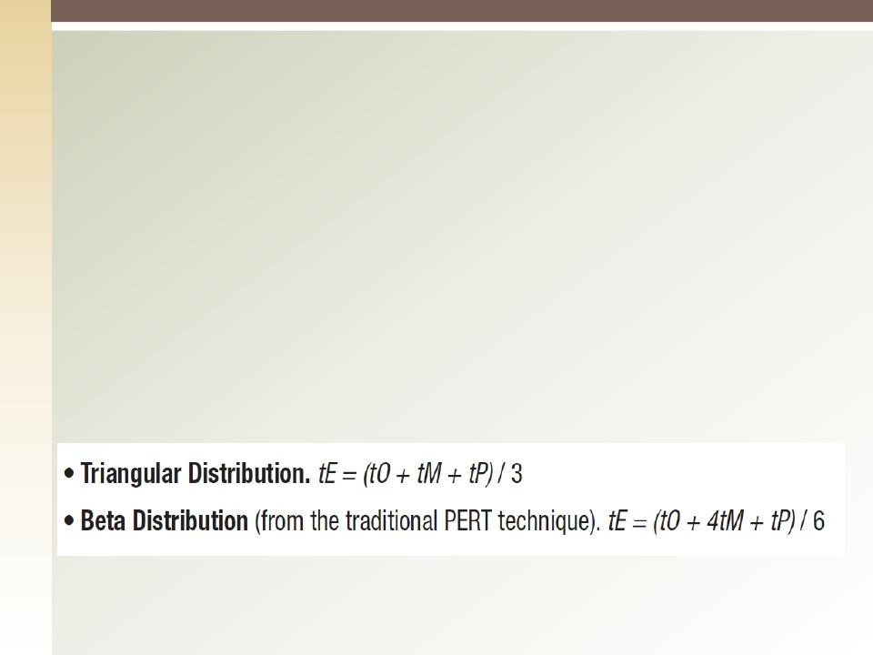
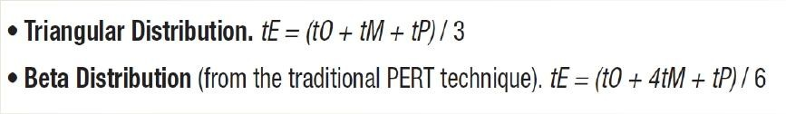
Estimate Costs: T & T
Expert Judgment
Analogous Estimating (Top down)
Parametric Estimating
Bottom-up estimating
Three-point Estimating

Slide 23
Estimate Costs: T & T
Reserve Analysis
Cost of Quality
Project Management Software
Vendor Bid analysis
Group Decision Making Techniques

Slide 24
Estimate Costs: Output
Activity Cost Estimates
Basis of Estimates
How it was developed
Estimation Assumptions
Constraints
Range of possible estimates (e.g., $100±10%)
Confidence Level of the estimate
Project Document Updates

Slide 25


Quiz
Analogous estimating:
uses bottom-up estimating techniques.
is used most frequently during the executing processes of the project
uses top-down estimating techniques.
uses actual detailed historical costs.

Slide 26


Quiz
The cost of choosing one project and giving up
another is called:
fixed cost.
sunk cost.
net present value (NPV).
opportunity cost.

Slide 27
7.3 Determine Budget
Aggregating the cost estimates of individual activities of work package to establish an authorized cost baseline.
An important goal of cost baseline is to have:
A time-phased budget that project managers use to measure and monitor cost performance
Estimating costs for each major project activity over
time provides management with a foundation for project cost control
Providing info for project funding requirements –at
what point(s) in time will the money be needed

Slide 28
Determine Budget: Inputs
Cost Management Plan
Scope Baseline
Activity Costs Estimates
Basis of Estimates
Project Schedule
Resource Calendars
Risk Register
Agreements
Organizational Process Assets

Slide 29
Determine Budget: T & T
Cost Aggregation
Reserve Analysis
Expert Judgment
Historical Relationships
Funding Limit Reconciliation

Slide 30
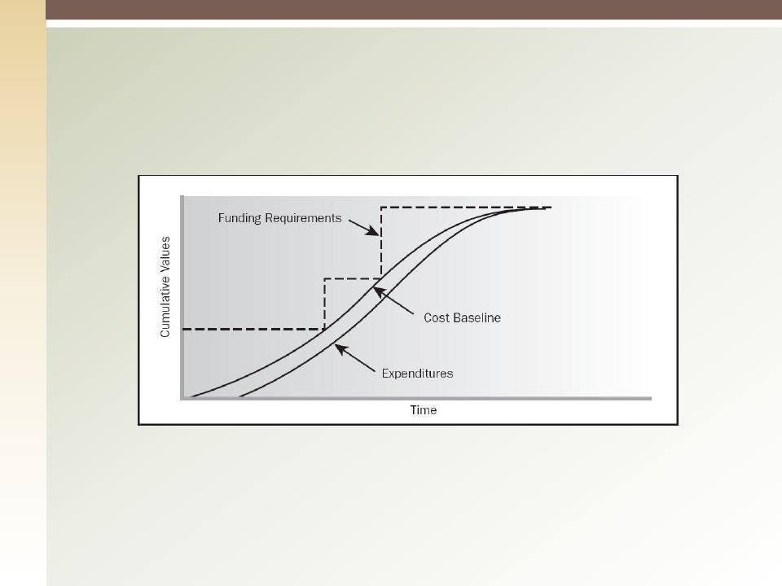
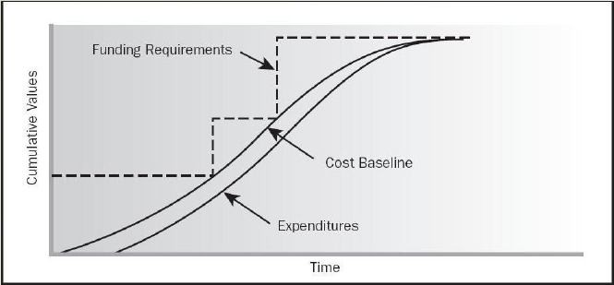
Determine Budget: Outputs
1. Cost Performance Baseline
Project Funding Requirements
Project Document Updates

Slide 31
7.4 Control Costs
Monitoring the status of the project costs and managing the changes to the cost baseline, includes:
Influencing the factors that create changes to the authorized
baseline
Monitoring cost performance to detect variances from the
plan
Ensuring that all appropriate changes are recorded
Preventing incorrect, inappropriate, or unauthorized changes
Informing the appropriate stakeholders of authorized
changes
Analyzing positive and negative variances and how they
affect the other control processes
30

Slide 32
Control Costs: Inputs
Project Management Plan:
Cost Baseline
Cost Management Plan
Project Funding Requirements
Work Performance Indicators
Organizational Process Assets

Slide 33
Control Costs: T & T
Earned Value Management
Forecasting
To-Complete Performance Index
Performance Reviews
Variance Analysis
Trend Analysis
Earned Value Performance
Reserve Analysis
Project Management Software

Slide 34
Control Costs: Outputs
Work Performance Measurements
Budget Forecasts
Change Requests
Project Management Plan Updates
Cost Baseline
Cost Management Plan
Organizational Process Assets Updates
Project Document Updates

Slide 35
Earned Value Management
EVM is a project performance measurement
technique that integrates scope, time, & cost data
Given a baseline, you can determine how well the project is meeting its goals
You must enter actual information periodically to use EVM.
34

Slide 36

EVM Terms
Planned Value (PV), formerly called the budgeted cost
of work scheduled (BCWS), also called the budget, is that portion of the approved total cost estimate planned to be spent on an activity during a given period
Actual Cost (AC), formerly called actual cost of work performed (ACWP), is the total of direct & indirect costs incurred in accomplishing work on an activity during a given period
Earned Value (EV), formerly called the budgeted cost of work performed (BCWP), is the percentage of work
actually completed multiplied by the planned value
35
◻
◻
◻

Slide 37
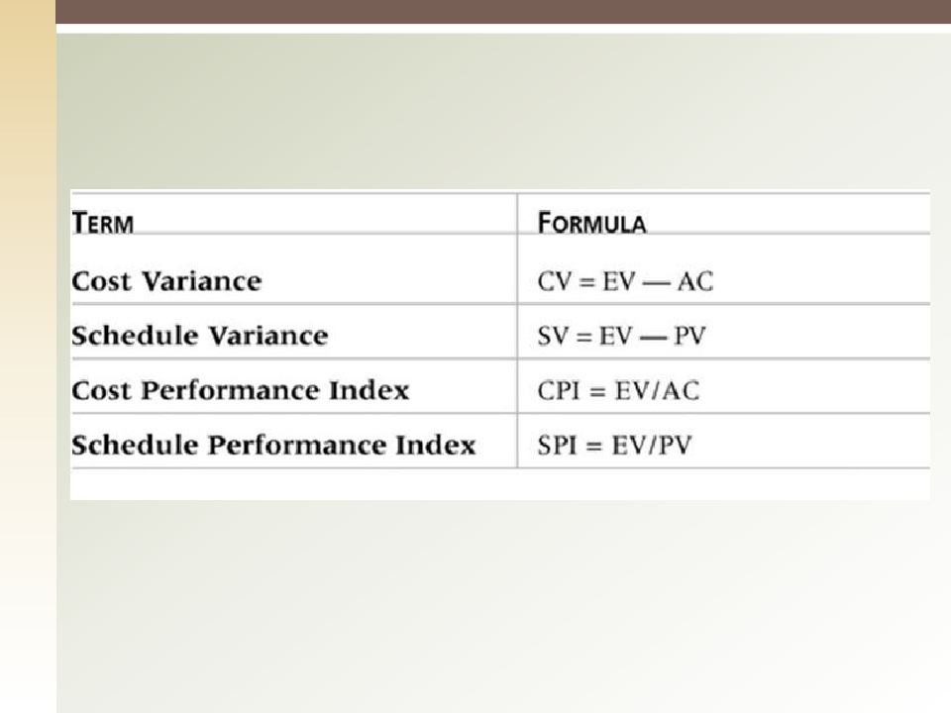
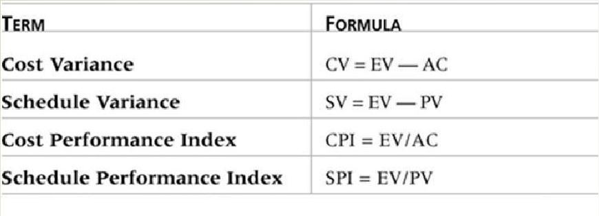
EVM Formulas

Slide 38
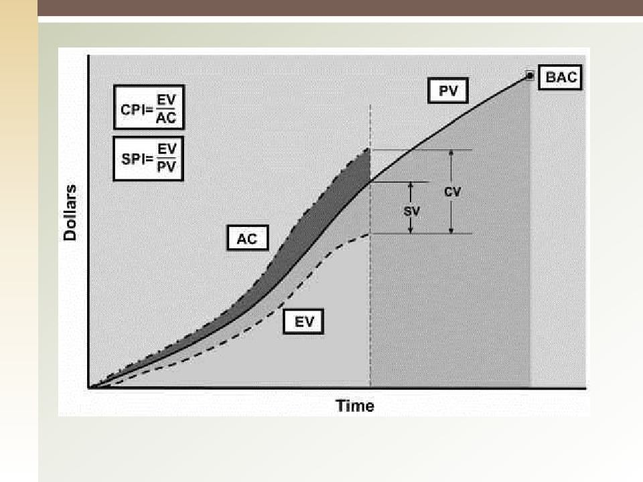
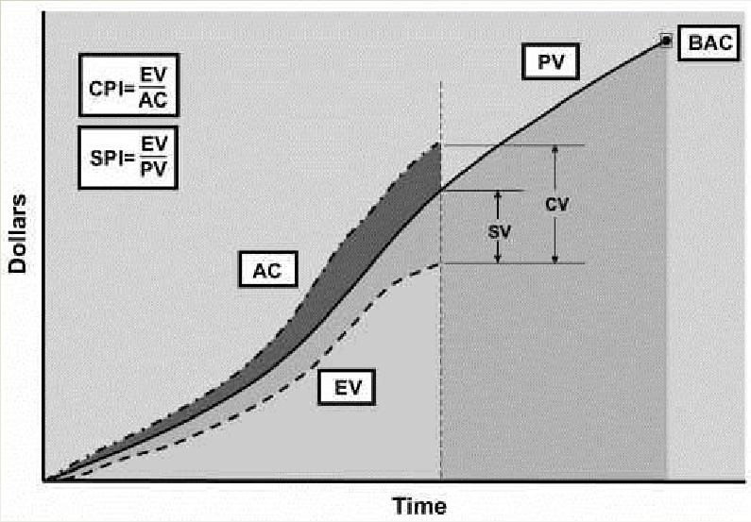

Slide 39
EVM Example
PV = $42,000 EV = $38,000 AC = $48,000
CV = EV – AC
= $38,000 - $48,000 = -$10,000
CV% = CV / EV
= -$10,000 / $38,000 = -26%

Slide 40
EVM Example – contd.
PV = $42,000 EV = $38,000 AC = $48,000
SV = EV – PV
= $38,000 - $42,000 = -$4,000
SV% = SV / EV
= -$4,000 / $42,000 = -9.5%

Slide 41
EVM Example – contd.
PV = $42,000 EV = $38,000 AC = $48,000
CPI= EV / AC
= $38,000 / $48,000 = 0.79
For each $1 spent, a work worth $0.79 was actually performed.

Slide 42
EVM Example – contd.
PV = $42,000 EV = $38,000 AC = $48,000
SPI= EV / PV
= $38,000 / $42,000 = 0.90
$0.90 worth of work was performed for each
$1.00 worth of work that planned to be done.

Slide 43
Estimate at Completion
The management’s assessment of the cost of the project at completion
After variance analysis, the estimated cost at completion is determined
Can use calculated indices or use management judgment.
◻
EAC = BAC / CPI (BAC=$80,000)
= $80,000 / 0.79 = 101,265

Slide 44
Variance at Completion
VAC = BAC - EAC (BAC=$80,000)
= $80,000 - $101,265 = -$21,265
Based on past performance, project will exceed planned budget by $21,265
ETC= EAC - AC (BAC=$80,000)
= $101,265 – $48,000 = $53,265

Slide 45
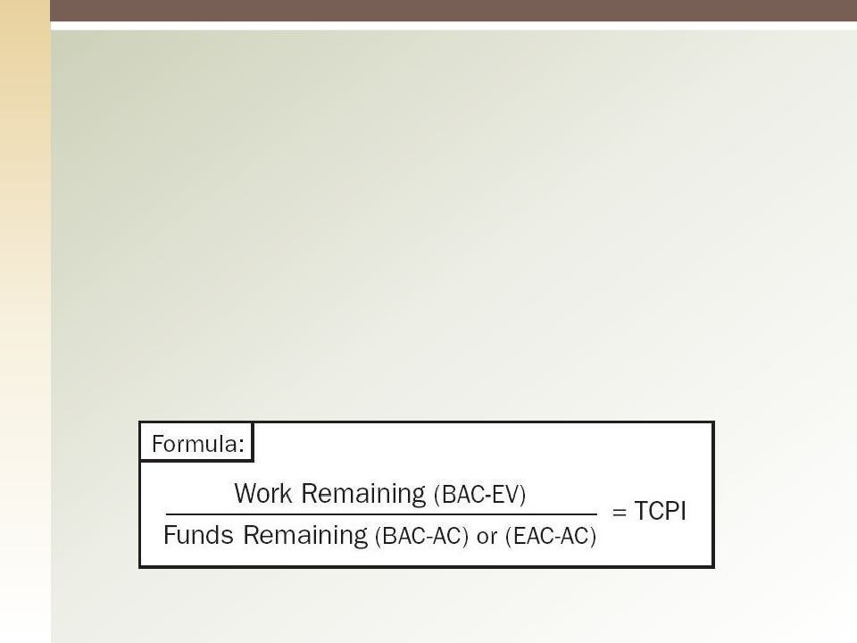
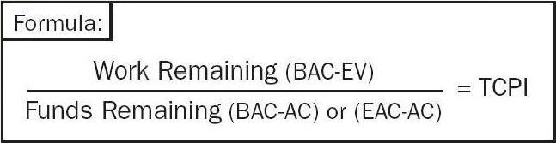
To-Complete Performance Index
How well do we have to perform to get back on track
The calculated project of cost performance that must be achieved on the remaining work to meat a specified goal (BAC or EAC).

Slide 46

Case 1
This is the ideal
situation, where everything goes according to plan.
• PV = $ 1,860
• EV = $ 1,860
• AC = $ 1,860
45

Slide 47

Case 2
In this Case, without Earned
Value measurements, it appears we’re in good shape. Expenditures are less than planned.
• PV = $ 1,900
• EV = $ 1,500
• AC = $ 1,700
Spending Variance
= EV – AC = - $ 200

Slide 48

Case 2
But with EV measurements,
we see...$400 worth of work is behind schedule in being completed; i.e., we are 21 percent behind where we planned to be.
• PV = $ 1,900
• EV = $ 1,500
• AC = $ 1,700
SV = EV – PV = - $ 400
SV % = SV / PV x 100 = - 21 %

Slide 49

Case 2
In addition, we can see...
“Actuals” exceed “Value Earned” (EV), i.e., $1,500 worth of work was accomplished but it cost
$1,700 to do so. We have a
$200 cost overrun (i.e., 13% over budget) .
• PV = $ 1,900
• EV = $ 1,500
• AC = $ 1,700
CV = EV – AC = - $ 200
CV % = CV / EV x 100 = -13 %

Slide 50

Case 2
This means only 79 cents worth of work was done for each
$1.00 worth of work planned to be done.
And, only 88 cents worth of work was actually done for each
$1.00 spent
• PV = $ 1,900
• EV = $ 1,500
• AC = $ 1,700
SPI = EV / PV = $ 0.79
CPI = EV / AC = $ 0.88

Slide 51

Case 2
This is the worst kind of
scenario, where all performance indicators are negative.
▪ PV = $ 1,900
▪ EV = $ 1,500
▪ AC = $ 1,700
SV = - $ 400; SPI = 0.79
CV = - $ 200; CPI = 0.88

Slide 52

Case 3
In this case there is bad news and good news.
◻ PV = $ 2,600
◻ EV = $ 2,400
◻ AC = $ 2,200

Slide 53

Case 3
The bad news is that our
work efficiency is a bit low; we’re getting only 92 cents of work done on the dollar. As a result, we are behind schedule.
◻ PV = $ 2,600
◻ EV = $ 2,400
◻ AC = $ 2,200
SPI = 0.92
SV = - $ 200; SV % = - 8 %

Slide 54

Case 3
The good news is that we’re under-running our budget. We’re getting
$1.09 worth of work done for each $1.00 we’re spending.
◻ PV = $ 2,600
◻ EV = $ 2,400
◻ AC = $ 2,200
CV = $ 200; CV % = 8 %
CPI = 1.09
53

Slide 55

Case 4
◻ PV = $ 1,700
◻ EV = $ 1,500
◻ AC = $ 1,500
In this case, the
work is not being accomplished on schedule...
SV = - $ 200; SV % = - 12 %
SPI = 0.88
55

Slide 56

Case 4
◻ PV = $ 1,700
◻ EV = $ 1,500
◻ AC = $ 1,500
...but the cost of
the work accomplished is just as we budgeted.
CV = $ 0.00
CPI = 1.00
56

Slide 57
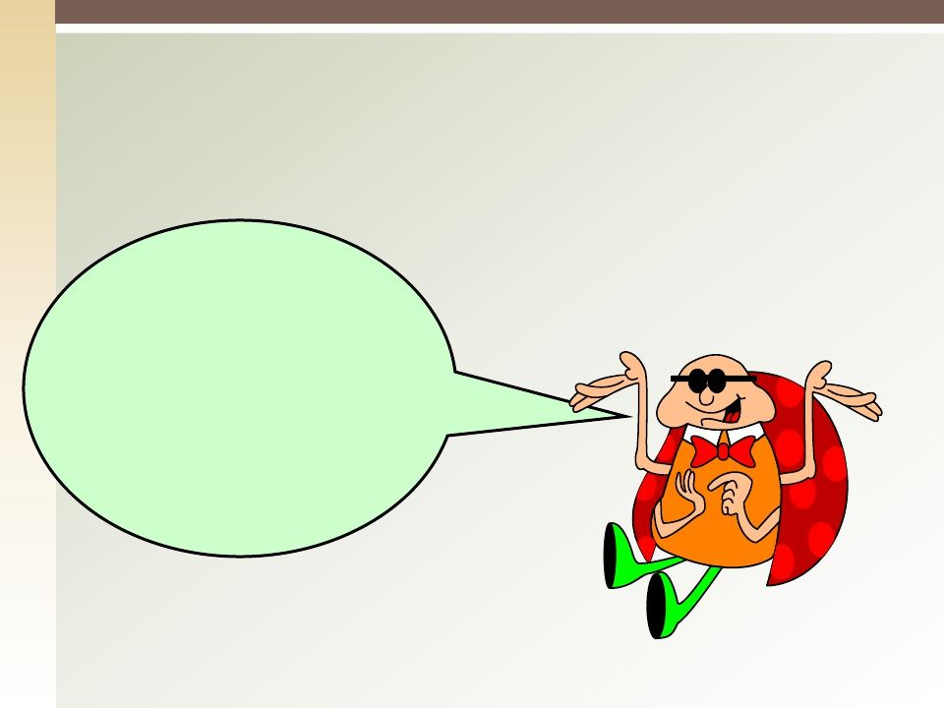
Case 5
◻ PV = $ 1,400
◻ EV = $ 1,600
◻ AC = $ 1,400
A positive scenario;
right? But is it because we are out- performing our learning-curve standards or because we planned too pessimistically?

Slide 58

Case 5
PV = $ 1,400
◻ EV = $ 1,600
◻ AC = $ 1,400
◻
Here in this case,
we are getting work done at 114 percent efficiency...
SPI = 1.14
CPI = 1.14

Slide 59

Case 5
◻ PV = $ 1,400
◻ EV = $ 1,600
◻ AC = $ 1,400
...work is ahead of schedule by 14 percent and
under-running cost by 12.5%.
SV = $ 200; SV % = 14 %
CV = $ 200; CV % = 12.5 %

Slide 60
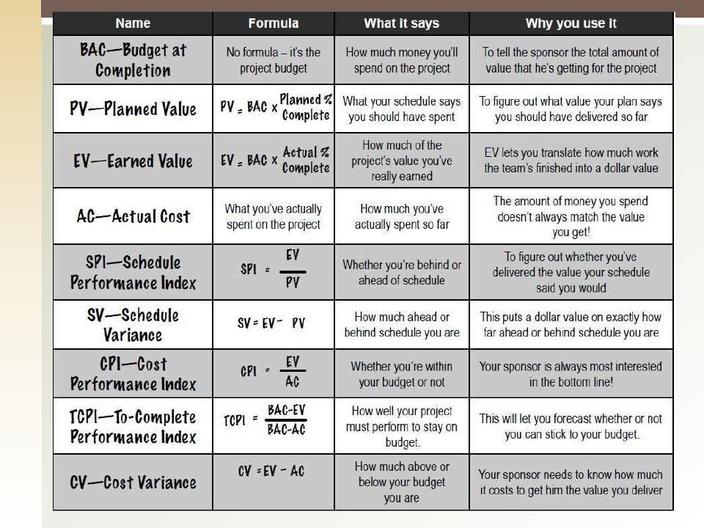
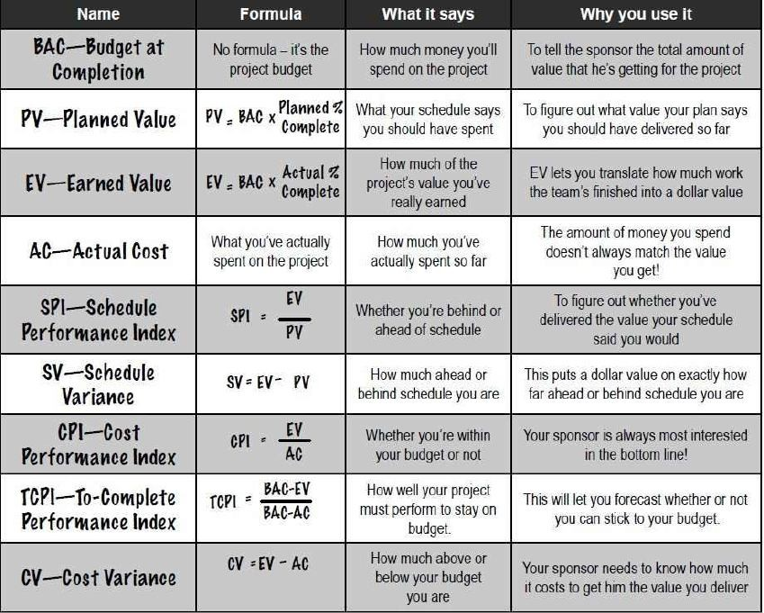
Text
Text
Text
59

Slide 61


Text
Text
Text
60

